Slide 1
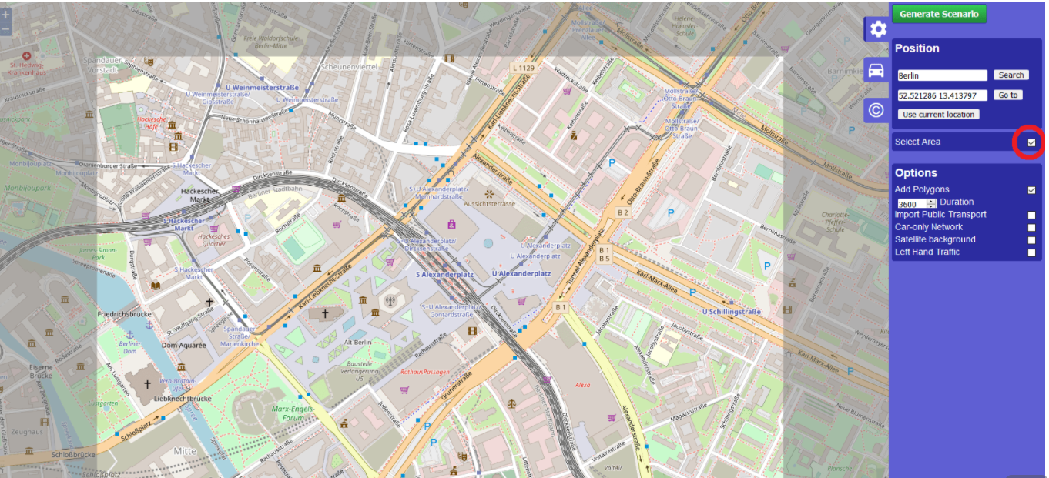
FCW Data Generation using Sumo Tool
OSM Web Wizard sumo tool is used to generate a traffic scenario
Using OSM tool ,select the number of vehicles needed in simulation

Slide 2
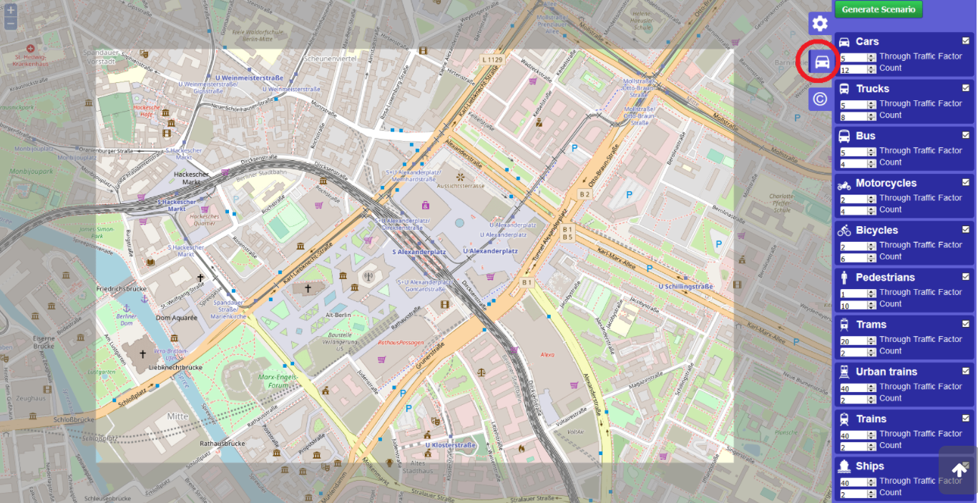
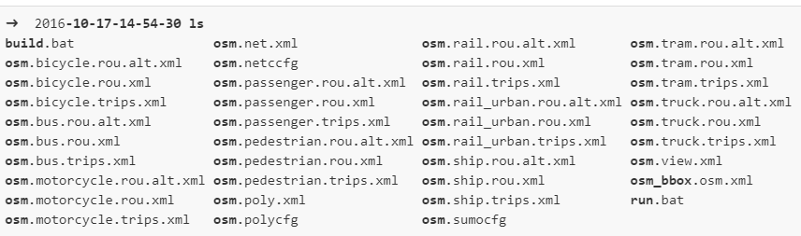
OSM tool generates a scenario which we can play and check
Tool automatically generates config files

Slide 3
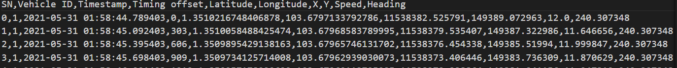
Manually edit the config files to edit routes to further fine tune the required routes.
Python script is written to read the generated config files .
Sumo Traci python tool API is used to read all vehicle and route parameters.
Using python script, the simulation can be played and at each step data generated is written to CSV files.
The generated CSV files are used by FCW simulator application program to send data in each row at a defined step to FCW algorithm .

Slide 4
Traci Tool
TraCI is the short term for "Traffic Control Interface". Giving access to a running road traffic simulation, it allows to retrieve values of simulated objects and to manipulate their behavior "on-line".
https://sumo.dlr.de/docs/TraCI/Interfacing_TraCI_from_Python.html
https://sumo.dlr.de/docs/TraCI.html
https://sumo.dlr.de/docs/Definition_of_Vehicles%2C_Vehicle_Types%2C_and_Routes.html

Slide 5
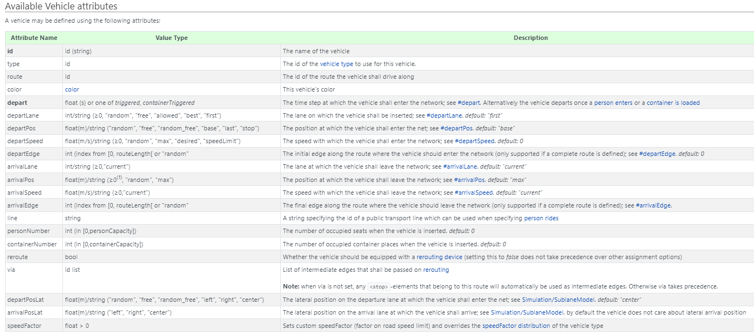
Vehicles and Routes

